Slide 1


Solar Heat for Industrial Processes Webinar series #3 - Fresnel Collector Technology
Irapua Ribeiro
17.06.2021

Slide 2
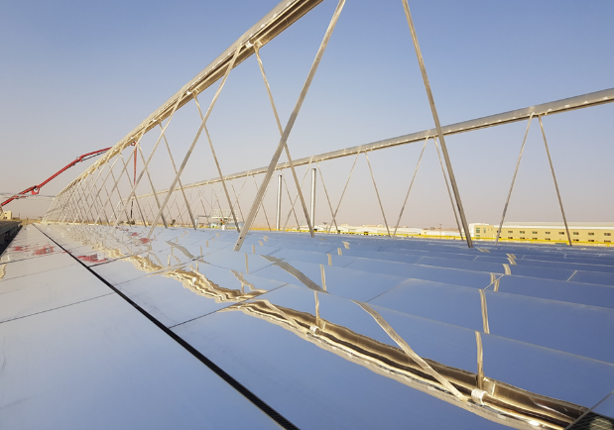
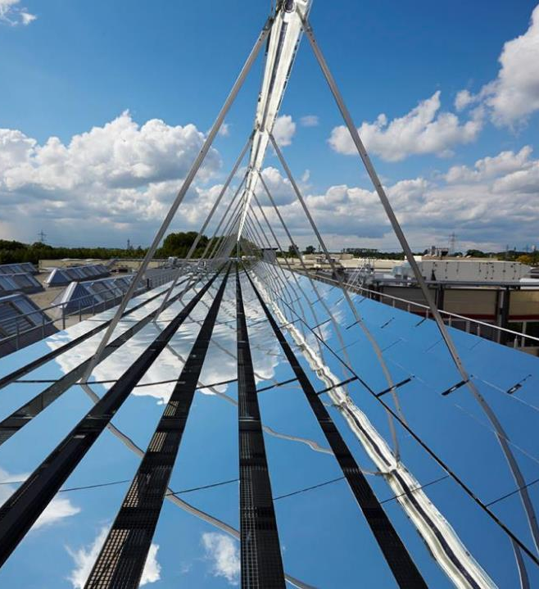
Fresnel Collector technology

Slide 3
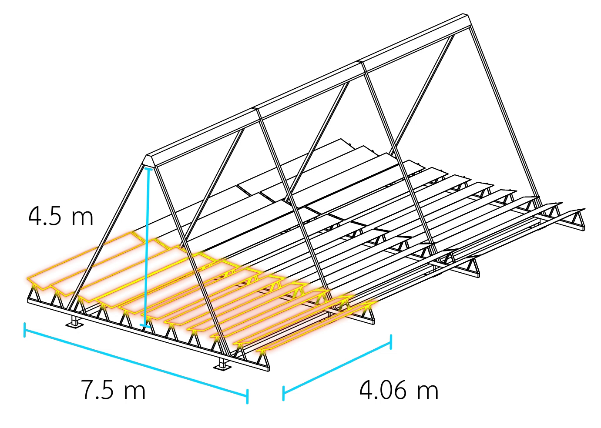

Fresnel Collector technology
Uniaxially tracked mirrors concentrate sunlight onto an absorber where heat is generated
27 kg/m²
Modular design, easily expandable
Lightweight structure allows rooftop installation
Generates heat up to 400 °C and 120 bar
Produces steam, heat up water or thermal oil
System lifetime: + 25 years

Slide 4
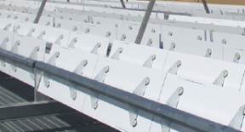
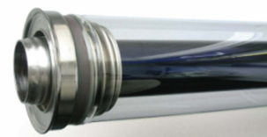
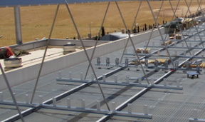
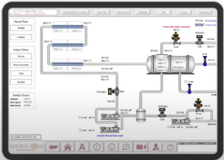
Fresnel Collector – Components
Mirror system (robust)
Absorber tube (high efficiency)
Support Structure (lightweight)
Control system (smart control)

Slide 5
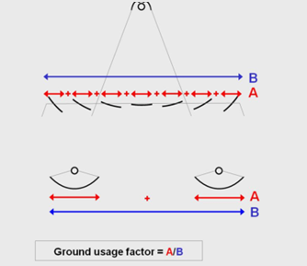

Fresnel Collector – Technology overview
Higher ground usage factor ~65% higher space efficiency (mirror area / ground area)
Space needs: 1 MW_{th} uses ~ 3000 m²
Low wind load Low exposure to wind → less structural loads
Good weight distribution Even distribution of the weight on the ground
Automatic operation, from sunrise to sunset Cleaning designs: automatic or manual
Low dust accumulation: stow position (e.g., 18h to 6h), self cleaning

Slide 6
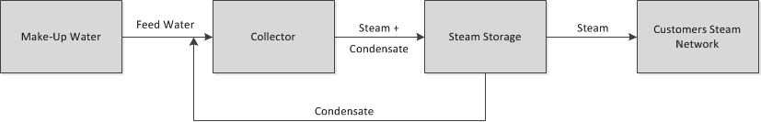
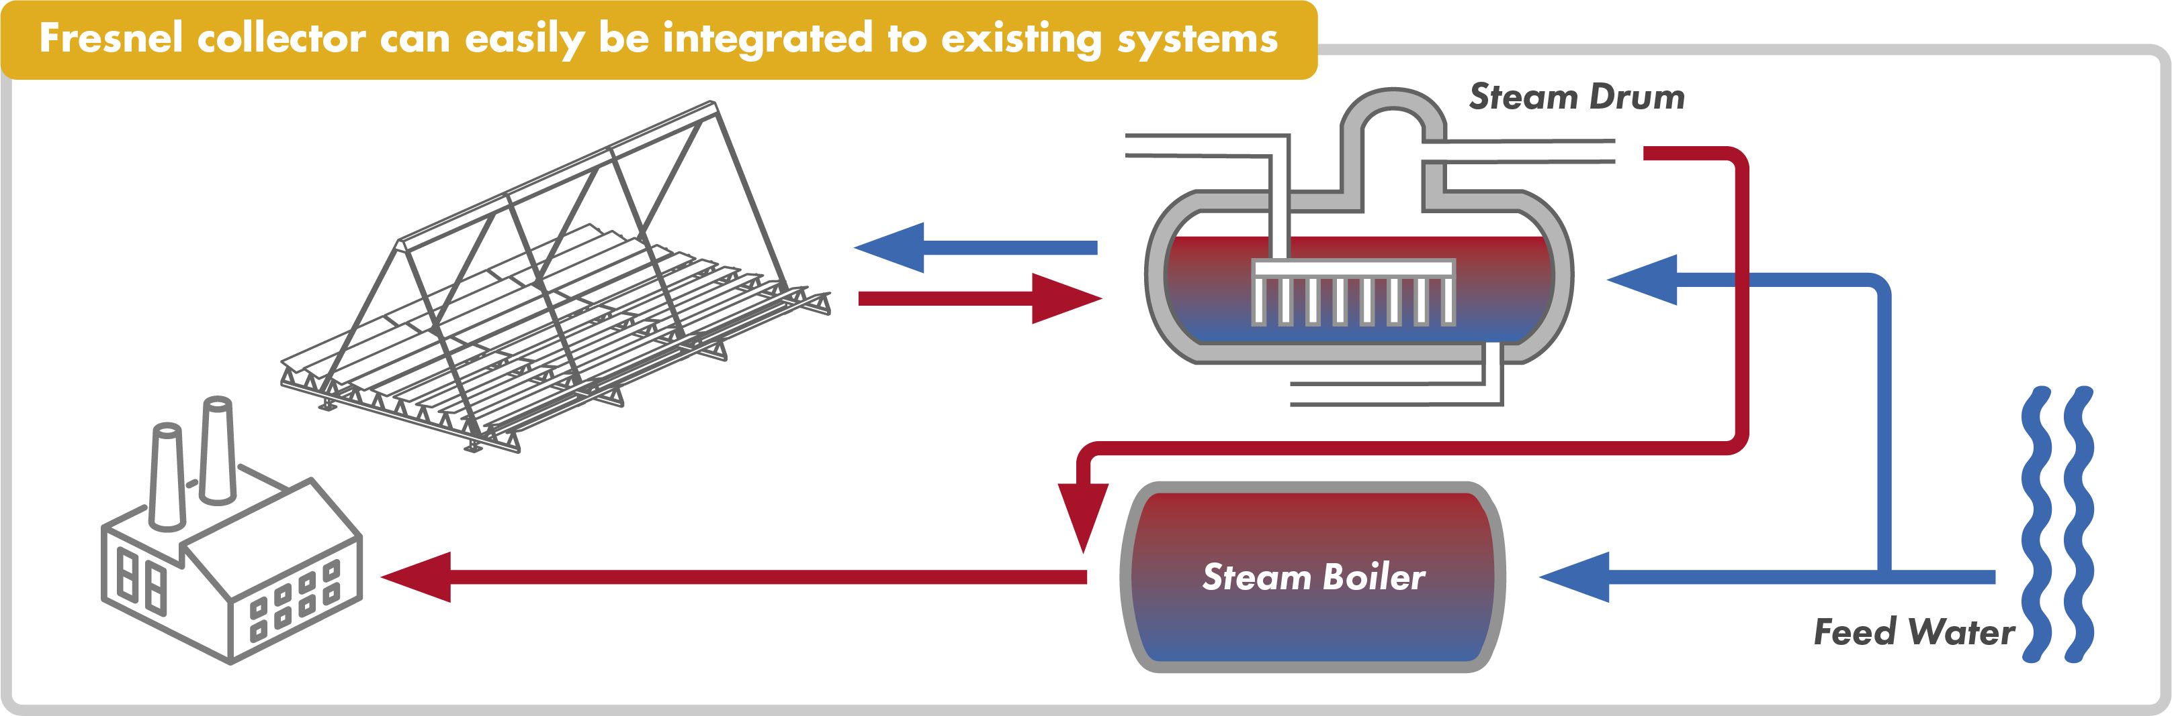
Fresnel System – Steam generation concept

Slide 7
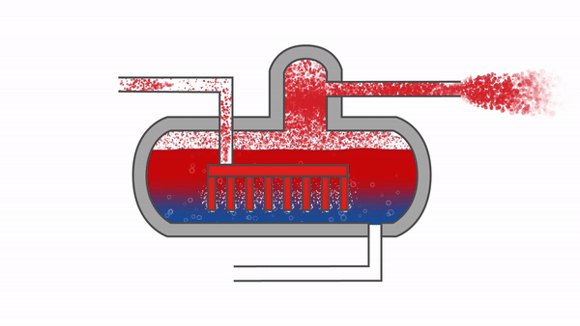
Fresnel System – Steam drum
Fresnel collector field
Industrial processes
Large pressure vessel
mainly filled with liquid water (80% of volume)
partly filled with steam (20% of volume)
Additional Functions of Storage
Two-phase separation
Expansion Vessel
Steam pressurization
Blow-down
De-Aeration
Anti-Freeze protection

Slide 8

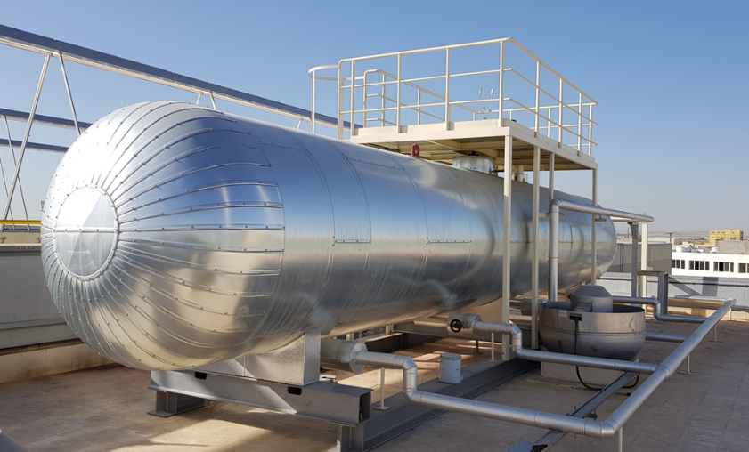
Fresnel System – Steam drum

Slide 9
Fresnel System – Operation Diagram
Data Center
Fluctuating DNI
Fluctuating Pressure in Drum
Very stable pressure in steam network due to solar generated steam
Without irradiation the fossil boiler provides steam
T collector out determined by steam drum pressure
Steam valve opening controls pressure in steam network

Slide 10
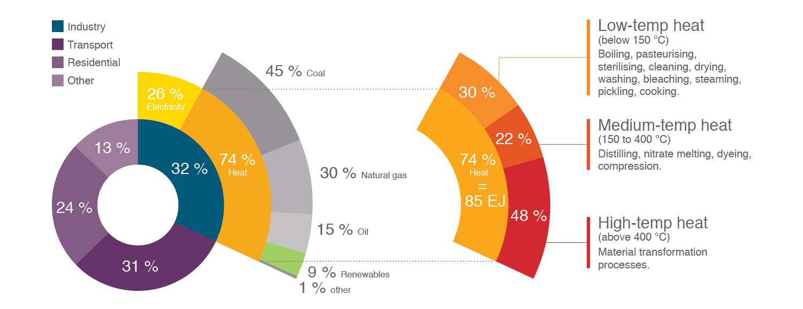
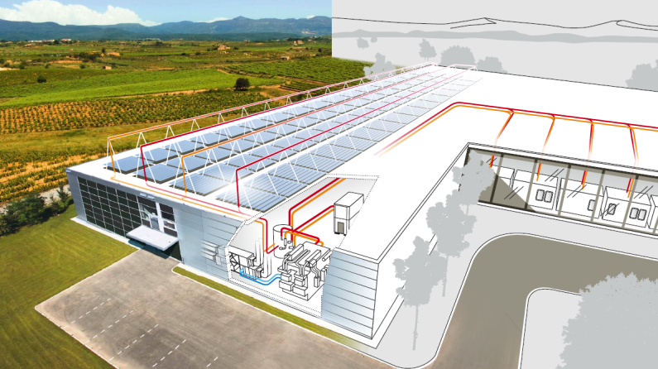
Fresnel System - Applications
Food & Beverage | Pasteurization / Blanching / Distillation / Cleaning
Textile | Dyeing / Drying / Washing
Pharma | Sterilization / Injection molding / Distillation
Paper | Bleaching / Cooking / Drying
Automotive | Drying / Electroplating / Blueing
Oil & Chemical | Distillation / EOR
Several industrial applications
Large energy requirements

Slide 11
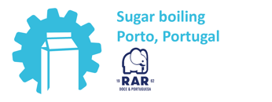
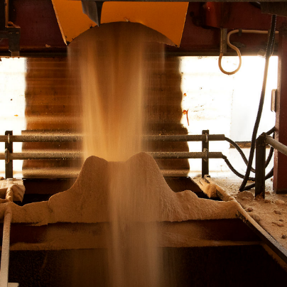

Demo site at RAR
RAR Açúcar is a company dedicated to the refining and selling of sugar
Solar steam will reduce fuel consumption and avoid emissions from burning fuel oil and natural gas
NEEDS
Heating
Sugar crystallization process: 125°C
Solar steam operation modes:
Main use: 1 bar(g) grid for all major processes and the degasser
Optional: 5 bar(g) grid used for cleaning (in continuous process)

Slide 12

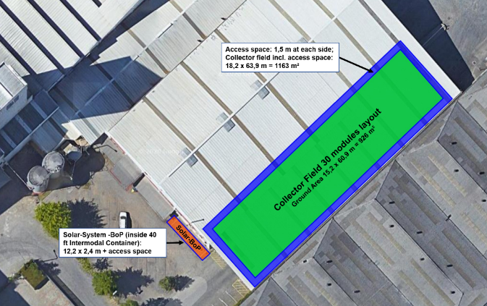
Demo site at RAR
Technology: Solar Fresnel Collectors
Solar field: 30 modules
Orientation: 47° from the N-S-axis
660 m² aperture area
Production: steam @10 bar
Under execution

Slide 13
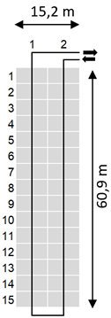
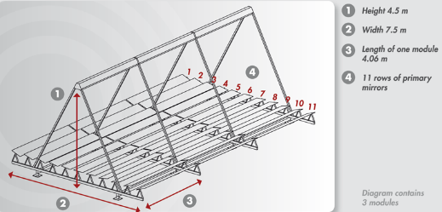
Demo site at RAR – System layout
30 modules (15 strings of 2 modules each)
690 m² aperture area
415 kW thermal power at reference conditions
926 m² ground space (15,2m x 60,9m)
+ access space of 1,5 m each side
75 % ground space efficiency

Slide 14
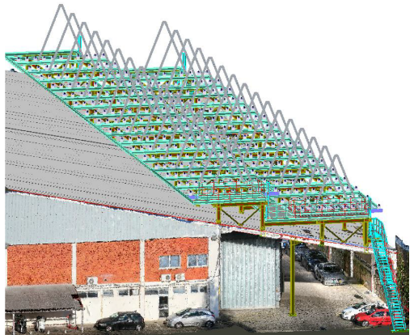
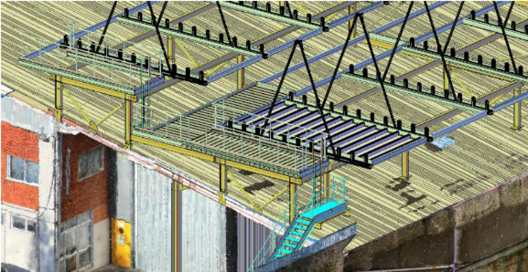
Demo site at RAR – Roof installation

Slide 15
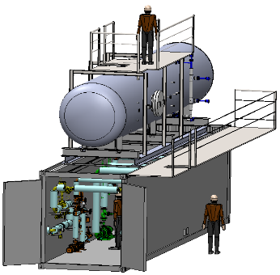
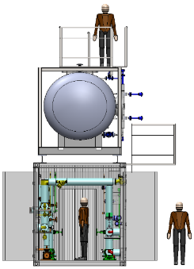
Demo site at RAR – BOP container
Steam storage and BOP Container
Replicability
Reduced costs (engineering, planning)
Pre-manufacturing & tests before shipping
Reduced installation time onsite
Short pipe ways from solar field to solar BoP
Clear definition of solar system interfaces
Storage capacity: 60 minutes and 415 kWh (1,5 GJ)

Slide 16

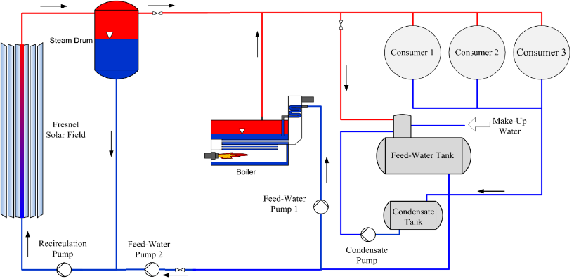
Demo site at RAR – Steam integration
Solar Steam Boiler
Existing Steam Network

Slide 17










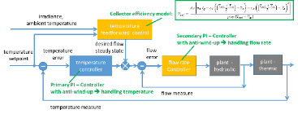
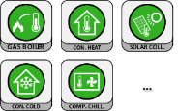
E) Distributed Learning
Features
Control Tool Framework modules related to plant
Goal: efficient & smart monitoring
Goal: future heat forecast
Goal: future heat forecast
Goal: future heat forecast
Goal: stable hydraulic condition
Goal: stable hydraulic condition
R_{hyd,A} >>
R_{hyd,A} >>
R_{hyd,B} <<
R_{hyd,B} <<
TES
TES
TES
TES
TES
TES
CHP
TES
CHP
CHP
CHP
CHP
CHP
CHP
Weather forecast
Weather forecast
Weather forecast
Weather forecast
Weather forecast
Weather forecast
Weather forecast
A) Control of solar thermal plant
A) Control of solar thermal plant
A) Control of solar thermal plant
A) Control of solar thermal plant
A) Control of solar thermal plant
A) Control of solar thermal plant
A) Control of solar thermal plant
Goal: optimal overall control
Industrial process
Industrial process
Industrial process
Industrial process
Industrial process
Industrial process
Industrial process
Solar thermal
Solar thermal
Solar thermal
Solar thermal
Solar thermal
Solar thermal
Solar thermal
17
17
17
17
17
17
17
Goal: stable temperature
Goal: stable temperature
Goal: stable temperature
Goal: stable temperature
Goal: stable temperature
Goal: stable temperature
Goal: stable temperature

Slide 18

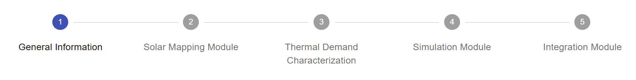
What is the Replication Tool?
The Replication Tool is a software able to evaluate the techno-economic potential of SHIP solution, starting from local solar potential and current process heat demand.
It gives:
Evaluation of solar field parameters
Expected energetic and environmental results
Preliminary economic figures.
Contact us if you want to receive a free assessment: info@ship2fair-h2020.eu

Slide 19


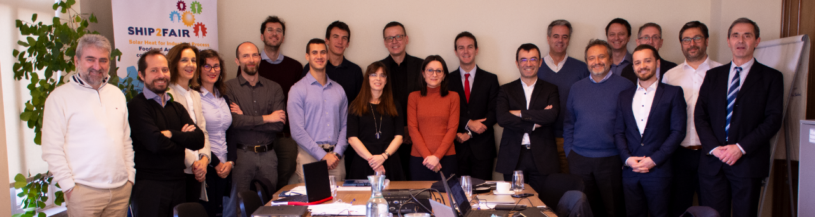
info@ship2fair-h2020.eu
www.ship2fair-h2020.eu
Thank you!

