Slide 1


RAR – Refinarias de Açúcar Reunidas 1st Webinar, 20/05/2021
Solar Heat for Industrial Process towards Food and Agro Industries commitment in Renewables
This project has received funding from the European Union’s Horizon 2020 research and innovation programme under grant agreement No 792276. Disclaimer: The sole responsibility for any error or omissions lies with the editor. The content does not necessarily reflect the opinion of the European Commission. The European Commission is also not responsible for any use that may be made of the information contained herein.

Slide 2
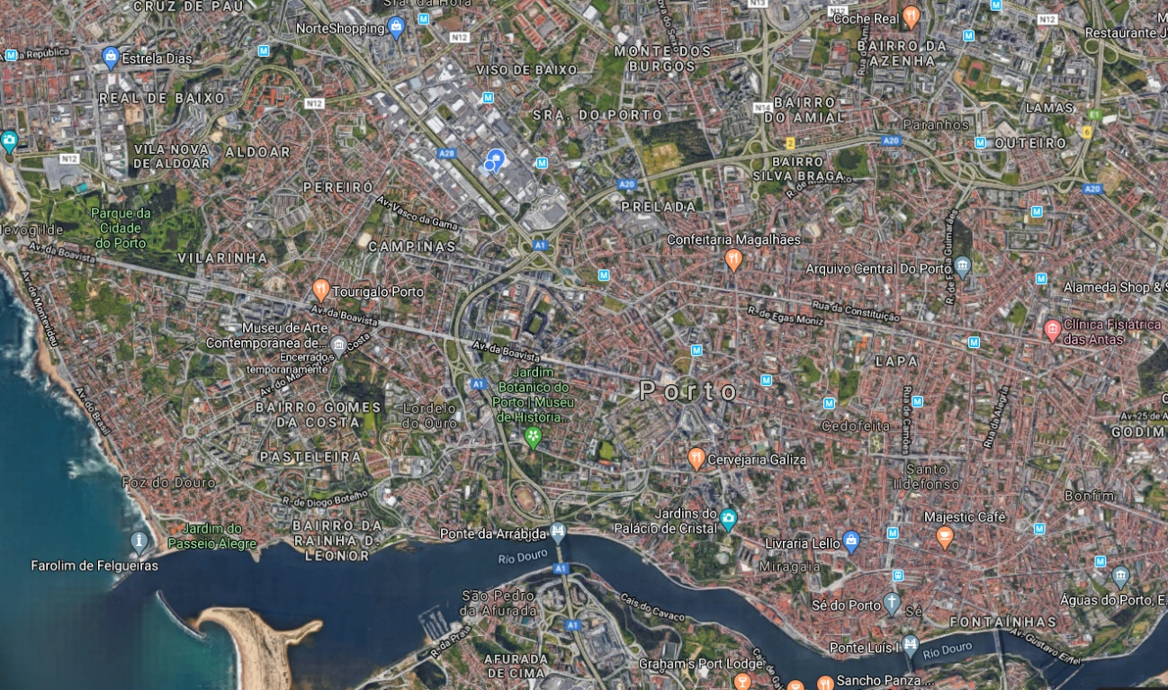
Location
Porto, Portugal

Slide 3
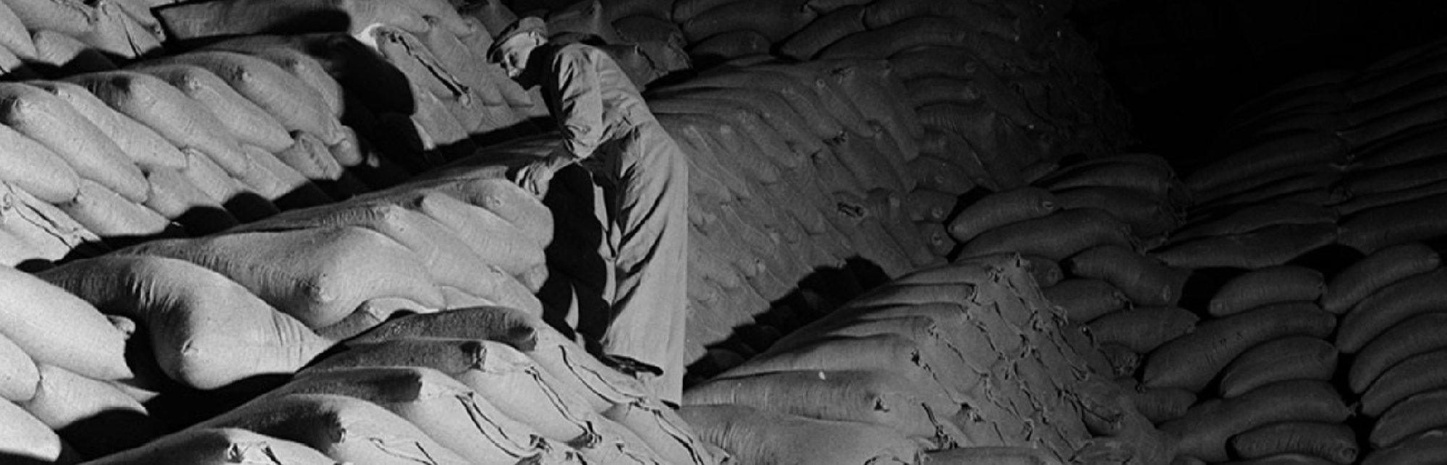
Historical overview
Until the 1960s, the Portuguese sugar refining industry consisted of a few dozen small-scale units, largely functioning in artisanal terms, with very rudimentary equipment, unable to produce quality sugar.

Slide 4



Timeline
Started operating
Expansion
With a current production capacity of over 240,000 t/year, RAR Açúcar has faced the 21st century with the determination to be a reference in the Iberian market, with innovative products and services and with a clear commitment to quality.
RAR Açúcar was founded in 1962, as a result of the concentration of 9 small sugar refining units in the north of the country
The company’s share capital was increased, and the Refinery’s production capacity was expanded
1962
1968
From 1991
1967
1973
Installed production capacity of 25,000 t/year. RAR sales in 1967 reached about 22,000 t, corresponding to 11.78% of the country’s production.
In 1973, RAR acquired the Refinaria Angola, located in Matosinhos, and its sales volume increased to around 45% of the national market.
Foundation
Expansion

Slide 5
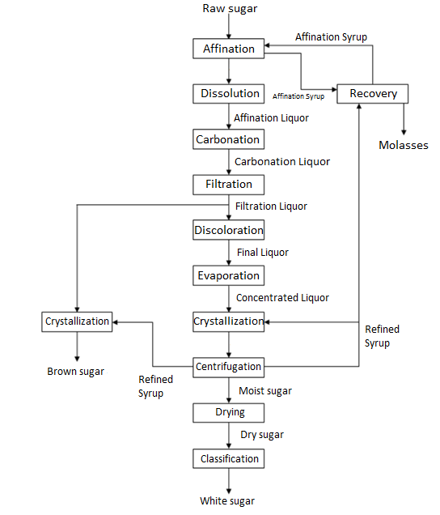
The process

Slide 6

Video

Slide 7
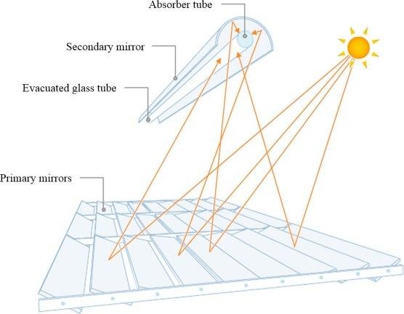
Energy demands
RAR’s steam demand is around 194.000 ton/year and the solar system will produce around 584 ton/year, which represents about 0,3% of our needs.

Slide 8
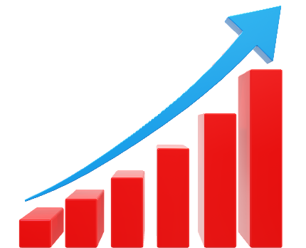
Improvements
Since the solar system is going to continuously operate and RAR is not, this steam production will decrease the startup time, which corresponds to approximately 1h of increased production time

Slide 9
Project analysis
RAR is a heavy-duty food company with high energy consumption
All actions that lead to a decrease in energy use and CO₂ production will have a positive impact on the city
RAR has the perfect and finest location for dissemination activities, since it takes only a 5min drive from the airport, it’s next to the city freeways and has connection by bus and metro.

Slide 10
edc@rara.pt

Slide 11
Status
Change of scope 80vs30
Formal agreement of the 2nd Amendment
Substructure engineering

