Slide 1

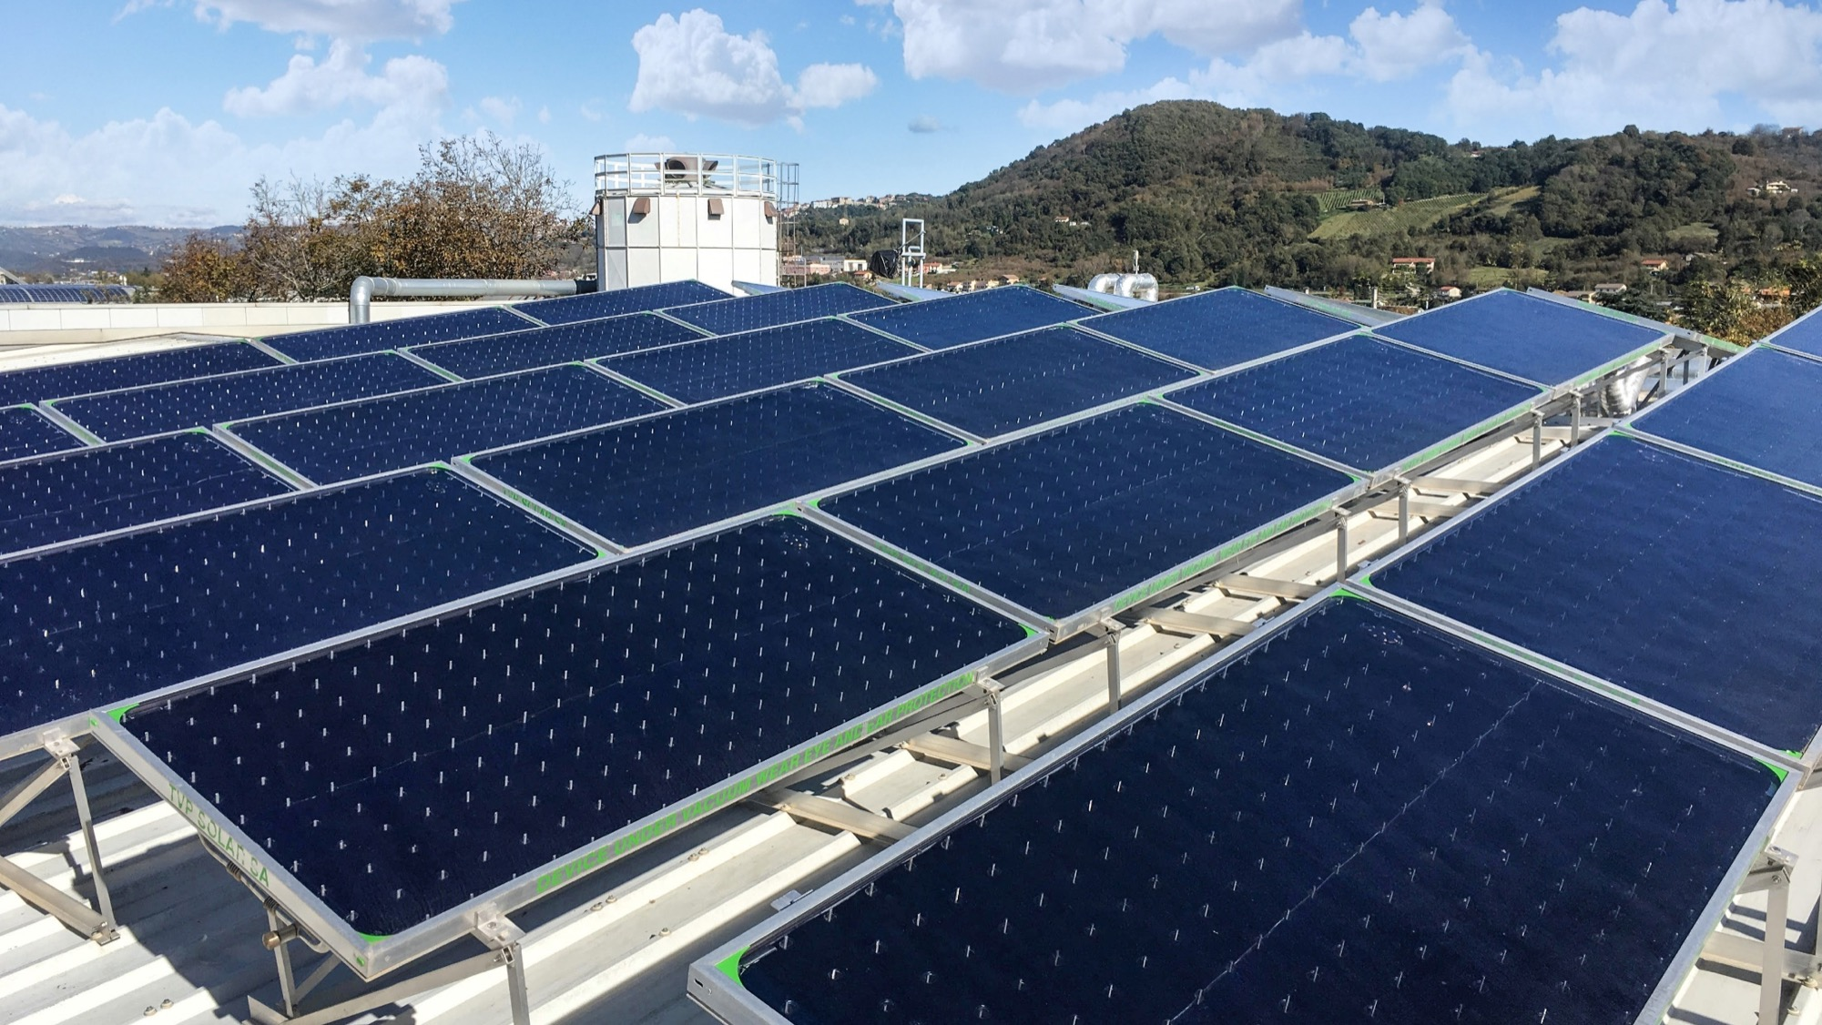
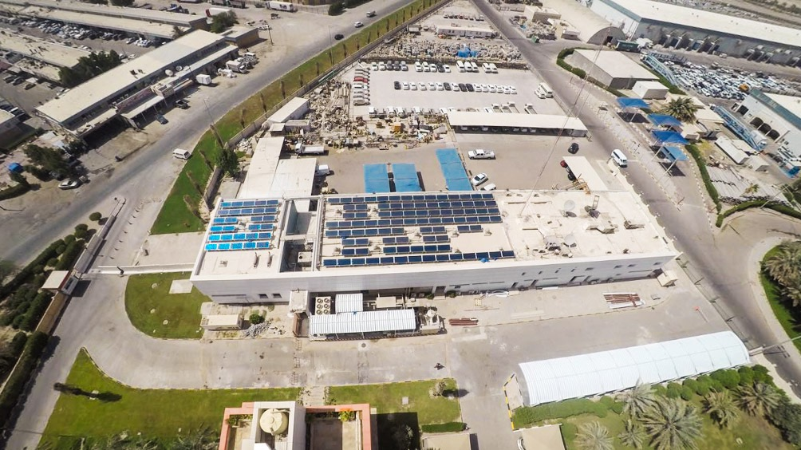


Thermal Vacuum Power
Innovative Solar Thermal Technology for
Low-to-Medium Heat Generation -
Demonstration under SHIP2FAIR
SHIP2FAIR project has received funding from the European Union’s Horizon 2020 research and innovation programme under grant agreement No 792276.

Slide 2
The World Best Solar Thermal Collector
SolarKeyMark certified best performance 65˚C to 200˚C
Best efficiency and highest energy production at any operating temperature, with any ambient temperature, in any climate condition
High-vacuum insulation suppresses thermal losses
20 yearsconsistent & predictable performance without any degradation
Designed for industrial-scale applications
Notes:
JUST READ
Stress the two key words of this page and of oue entire technology: HIGH-VACUUM + FLAT

Slide 3
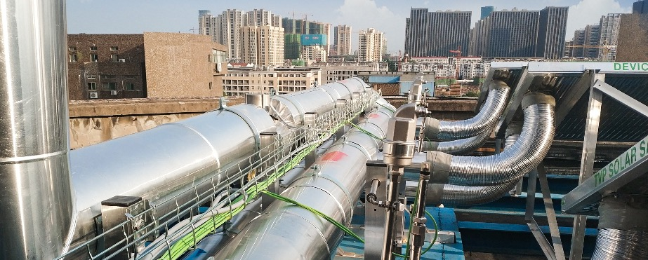
TVP Value Proposition
The Cheapest Thermal Energy
Primary Target Indust ries
TVP < 0.03 USD/kWh_{th}
Cut OPEX
Food
Beverage
Dairy
Agricultural
Paper
Text ile
Oil & Gas Pharma Chemical Automotive Mining
Dist rict Networks
Achieve Sustainability Targets
TVP cuts fossil fuels
TVP cuts CO₂ emissions
Stabilize Energy Supply
Consistent energy output
Energy cost fixed for 25 years
Primary Target Processes
Pre-heat water
Boiler feedwater
Sterilization
Past eurization
Drying
Dying
Water treat ment AC & cooling
Washing Pressing
Bleaching Decreasing

Slide 4
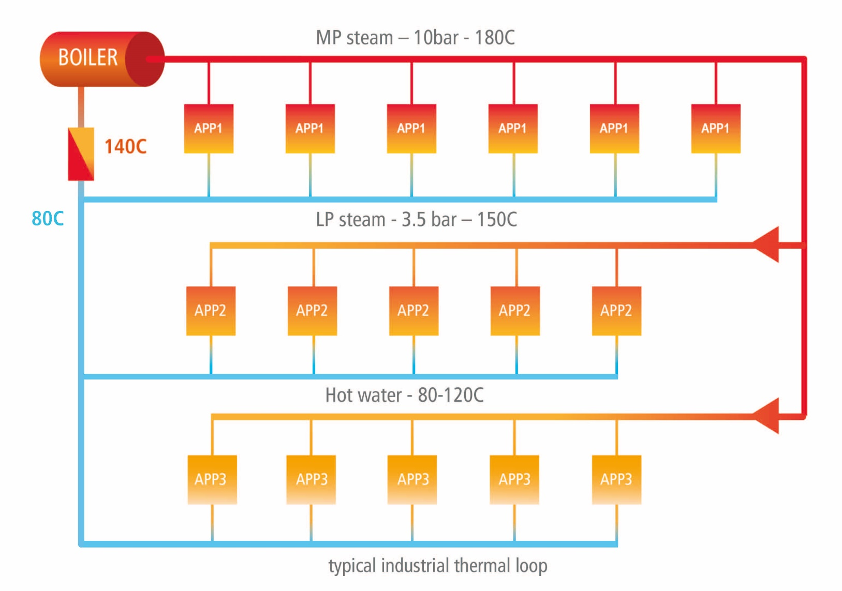

Seamless Integration to Industrial Processes
TVP’s solar thermal system can be seamlessly integrated with existing thermal systems at different levels
integrate here
pre-heating
…or here via
low pressure steam
…or directly here
process machine
Notes:
Industry uses fuel to produce hot water and steam to drive different process throughout the factory. Dryers, Hot Tanks, Sterilizers, etc.
Steam is the vector, which is then condensed to transfer heat to process machines
Several process machines can be driven by hot water as well
TVP Solar Process Heat produces fuel free, carbon free, cheaper hot water to drive industrial process
Pre-Heating (burner, boiler)

Slide 5
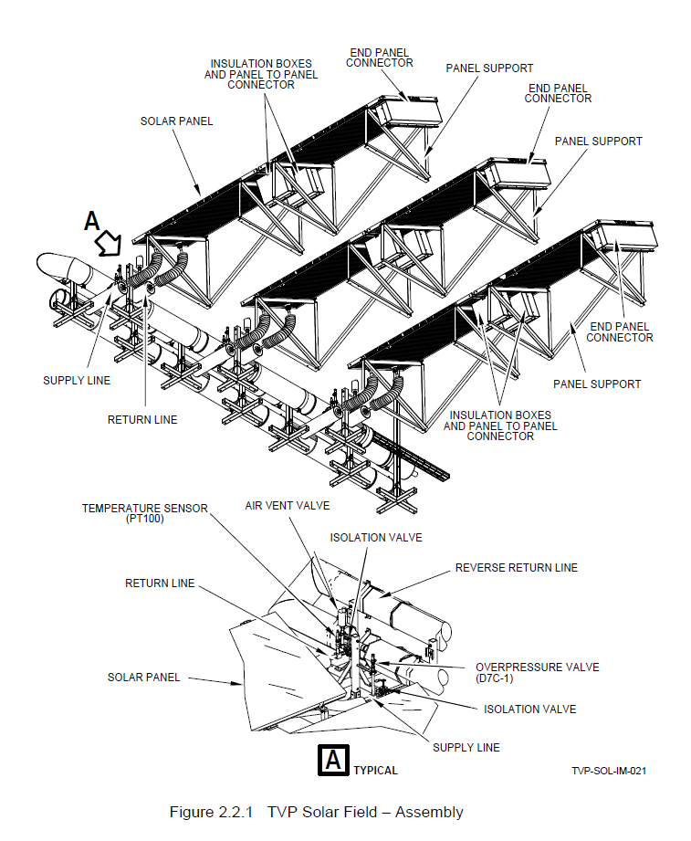
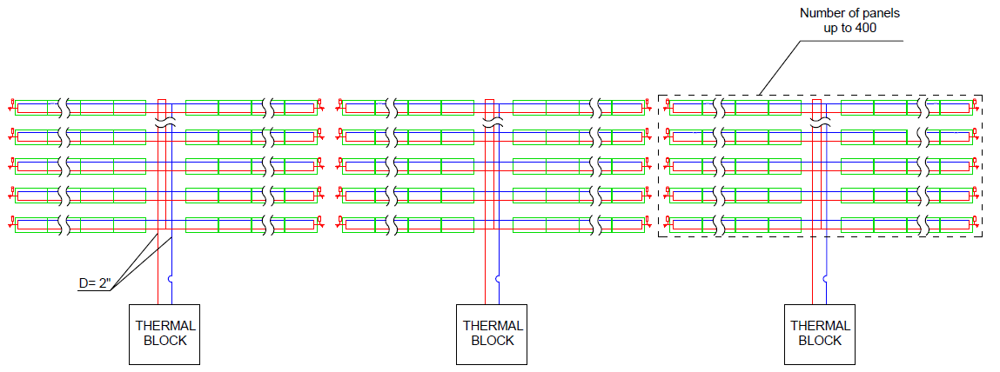
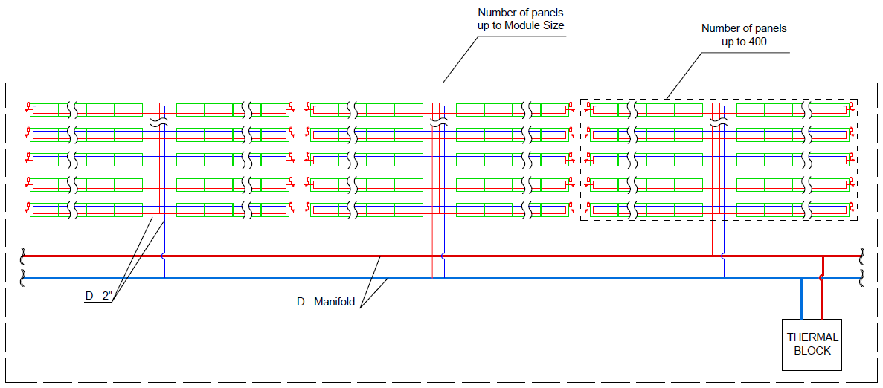
Standardized and Modular Solar System
Standardized solar system components ease installation and maintenance
Modularity to adapt to any size and every requirement
5000
5000

Slide 6

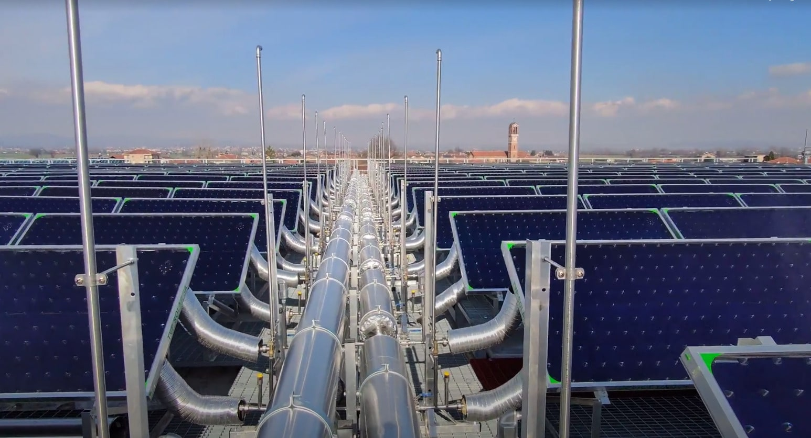

SHIP2FAIR
Steam Generation – Summer
Space Heating – Winter
‘Martini & Rossi SpA’ Case Study - Italy

Slide 7
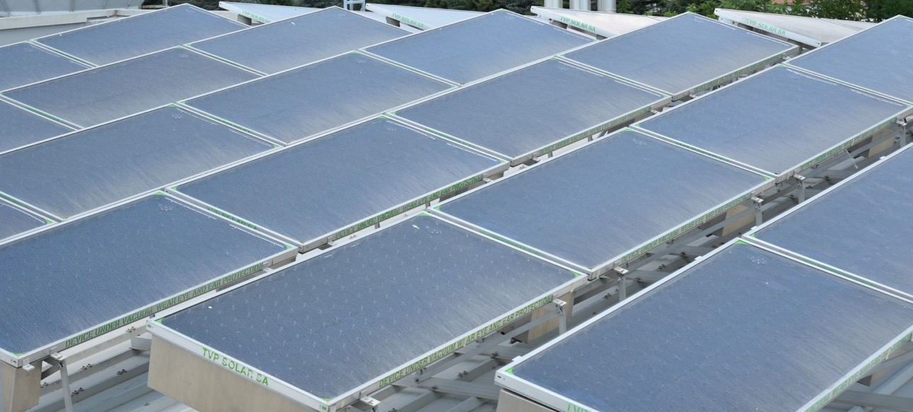

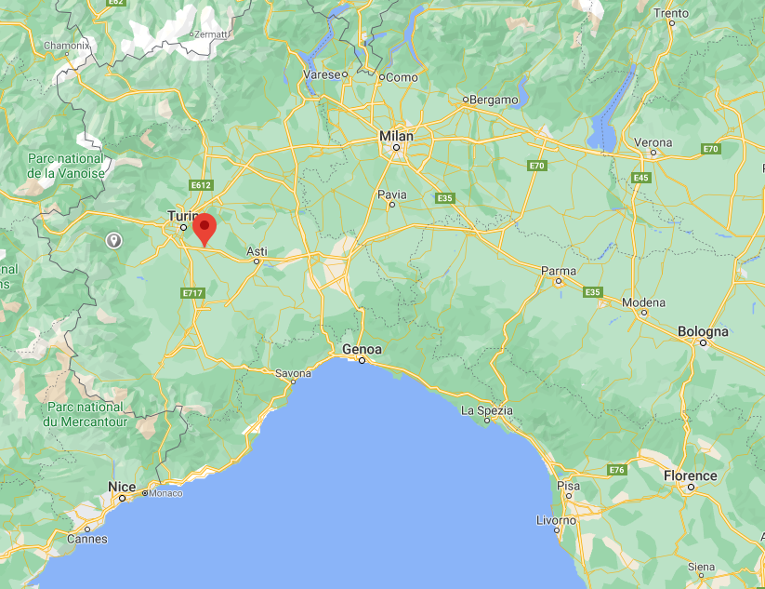
Solar Process Heat at M&R: Overview
Context: Demonstration site under the H2020 SHIP2FAIR project
Solar thermal technology: High Vacuum Flat Panels (HVFPs)
Site & Location: Alcoholic beverage plant – Pessione, Turin, Italy
Global Horizontal Irradiance: 1332 kWh/m²
Installation: Rooftop
Collector surface: 596 m2
Installed Power: 327 kWp
Energy production: 349,403 kWh/y (586 kWh/m2/y)
Configuration: Oct-Mar: Hot water. Operating T: 90ºC (outlet)
Apr-Sep: Steam. Operating T: 170ºC (outlet)
Installation completed: Dec 2020;
Commissioning winter mode: Feb 2021
Commissioning summer mode: On-going

Slide 8

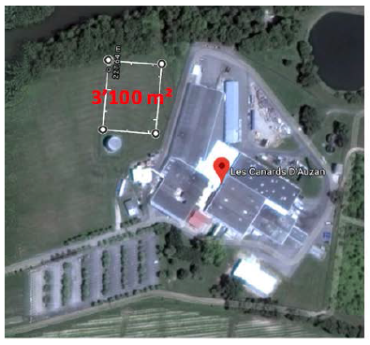

Upcoming Demo
Technology: HVFP
Solar Field size: 1600 m² – 1MW_{th}
Cascade application:
Boiler feed water pre-heating @140C
Water tank heating @65C
Status:
On-going ground preparation works
Regulatory permissions partly issued (1 of 2)

Slide 9
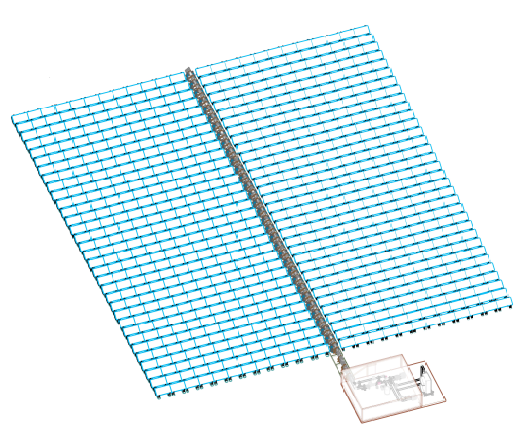
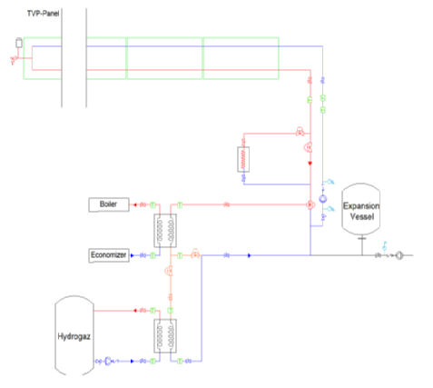
Larnaudie solar system: engineering
Solar Field
Simplified P&ID
Technical room

Slide 10

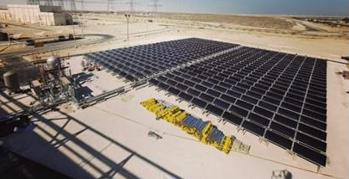
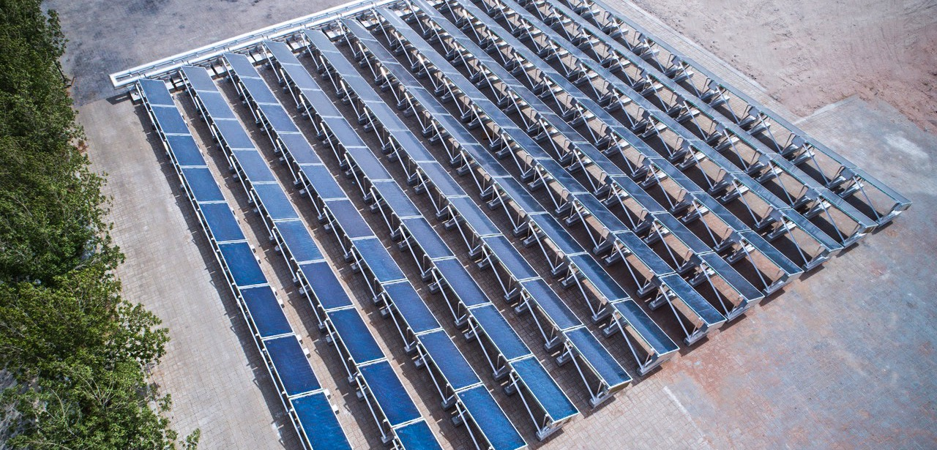
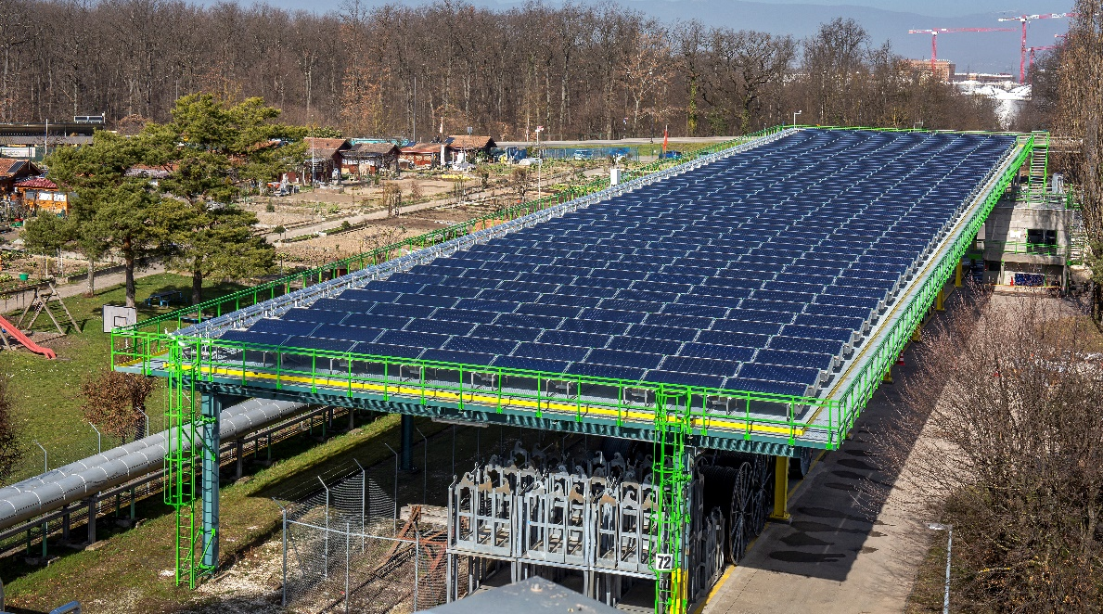
papageorgiou@tvpsolar.com
Questions?

