Slide 1

3rd Webinar How to choose the right solar thermal technology for your industrial processes
General Presentation of the project
www.ship2fair-h2020.eu
17/06/2021
info@ship2fair-h2020.eu

Slide 2



CONTEXT
Decarbonization pathway for industry
Key plans towards Sustainability
Energy consumption in Industry
SHIP
Solar heat integration in industrial processes
BUDGET: 8 M€
DURATION: 2018-2022

Slide 3
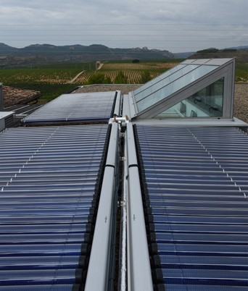

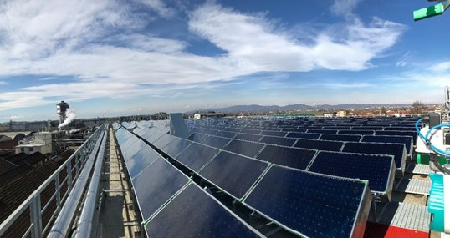
OBJECTIVE
Unveiling the untapped potential of solar heat for agroindustries in EU
Fostering the integration of solar heat in industrial processes (SHIP) from agro-food sector, by developing and demonstrating a set of tools and methods.
BUDGET: 10 M€
DURATION: 2018-2023

Slide 4
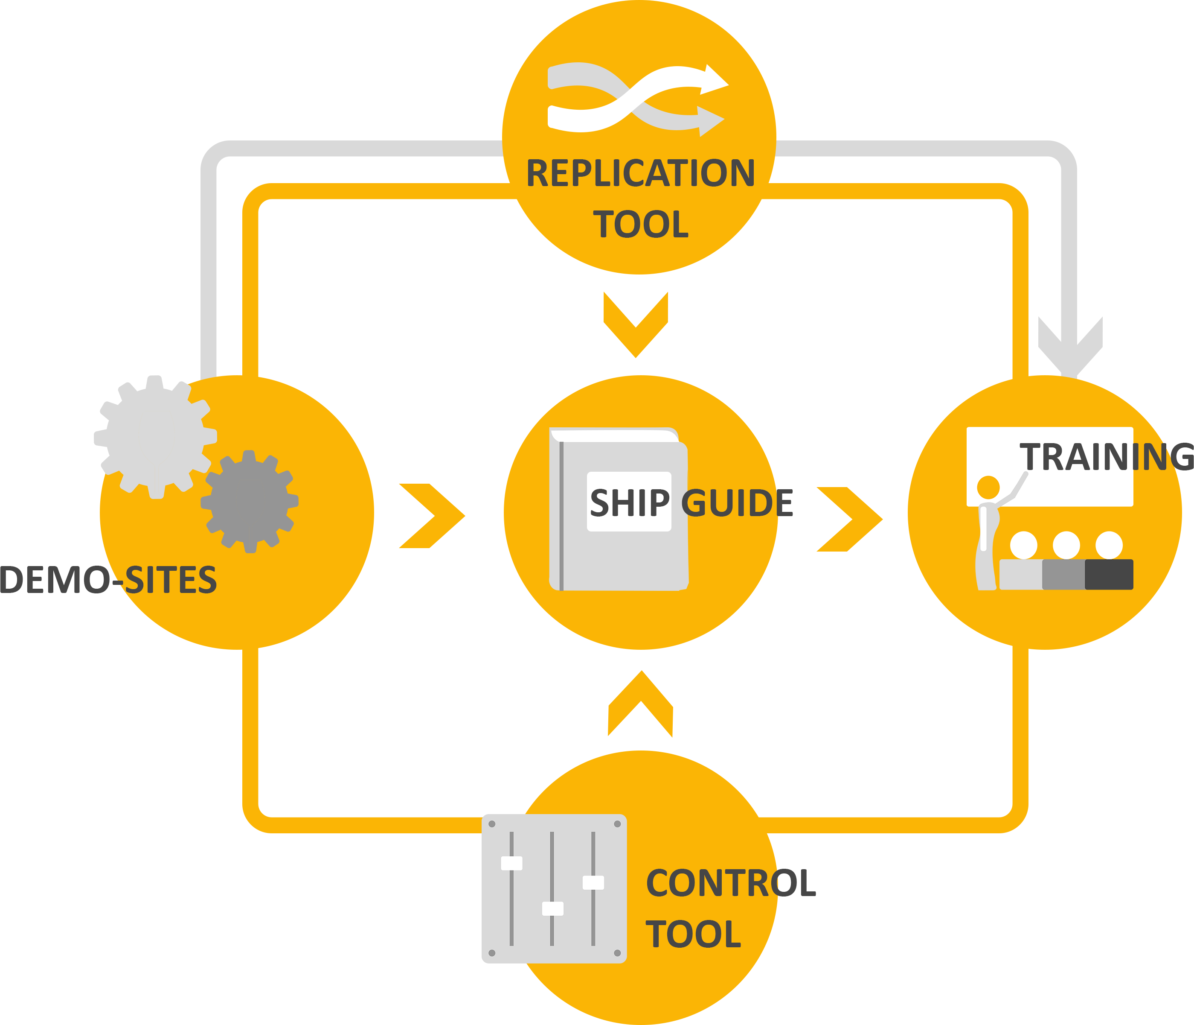

TOOLS & METHODS
SHIP2FAIR develop & demonstrate, in a minimum of 4 real industrial sites - demo-sites, a set of tools & methods for the development of industrial solar heat projects.
Software to support the concept design of SHIP projects & the development of feasibility studies
Deploy SHIP installations tested in 4 industrial sites.
Training, making use of use-cases.
Decision Support System to improve the control and optimize the operation of SHIP installations combining supply and demand data

Slide 5








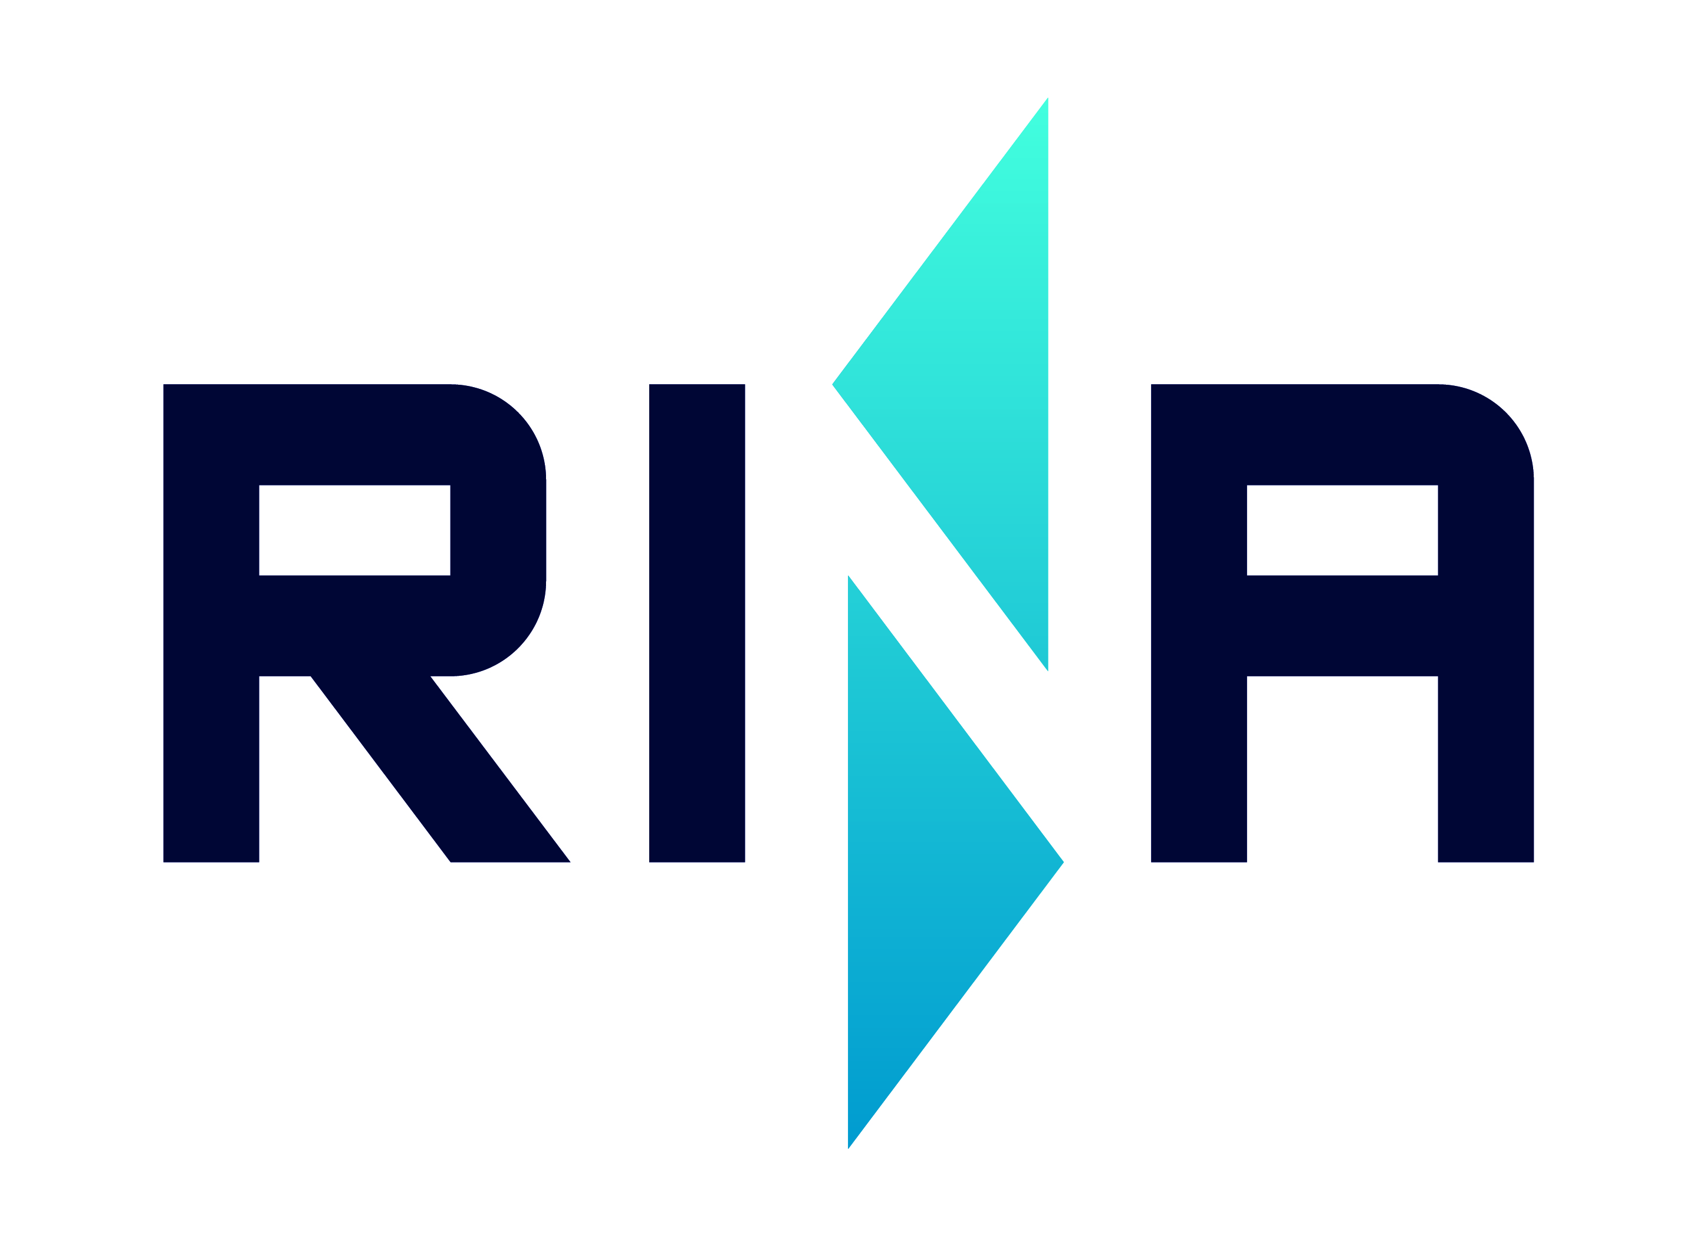






Partners
Coordination
Solar technologies providers
R&D and consulting
Agro-food field experts
Dissemination & Training

Slide 6


How to choose the right solar thermal technology for your industrial processes?
Dimitrios Papageorgiou (TVP Solar),
Christophe Dumas (CEA-French Alternative Energies and Atomic Energy Commission )
High Vacuum flat collectors
Overview of the relevant technologies for agro-food sector
Irapua Ribeiro (Industrial Solar)
Fresnel collectors

