Slide 1

The SHIP2FAIR Replication Tool Webinar, 19/05/2021

Slide 2
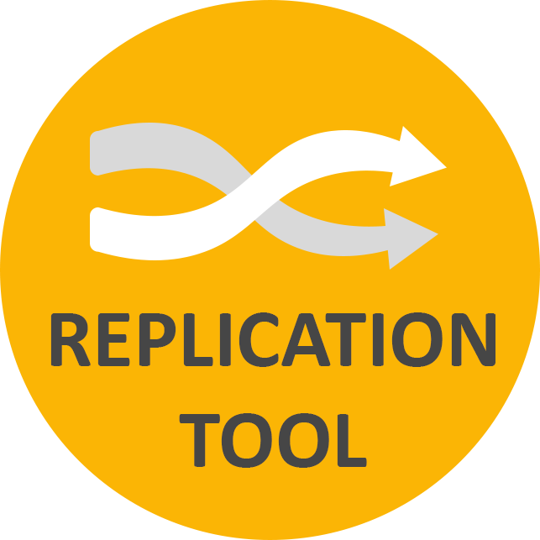
Replication Tool
The Replication Tool is a software able to evaluate the techno-economic potential of SHIP solution, starting from local solar potential and current process heat demand.
This tool is able to provide a first outlook on the SHIP integration within the process and to optimise the system according to the user’s needs.
It provides:
Evaluation of solar field parameters (sizing, technology, thermal storage requirements, etc.)
Expected energetic and environmental results (solar fraction, energy savings, avoided emissions, etc.)
Preliminary economic figures.

Slide 3
Replication Tool
ADVANTAGES:
Not specialised tool
Interactive interface
Default values suggested
Inputs required available to the user
Optimisation of the solar field based on a selected parameter
Possibility to compare alternatives
USER:
Professionals to develop feasibility studies
Technical department of interested companies
Consultants
Students

Slide 4
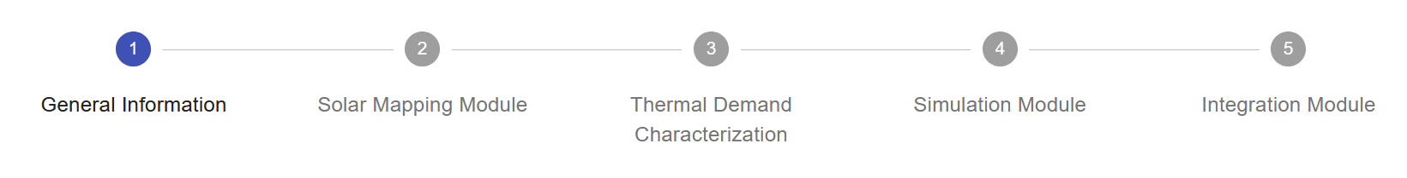
How does the RT work?
The Replication Tool (RT) is a web tool, which allows registered users to run 5 modules in sequence:
General Information Module
Solar Mapping Module
Industrial Process Demand Characterization Module
Simulation Module
Solar Integration Module

Slide 5
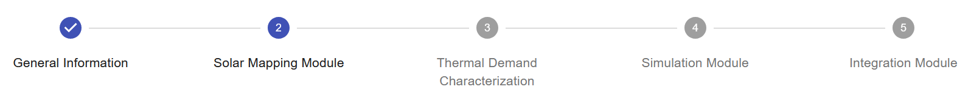
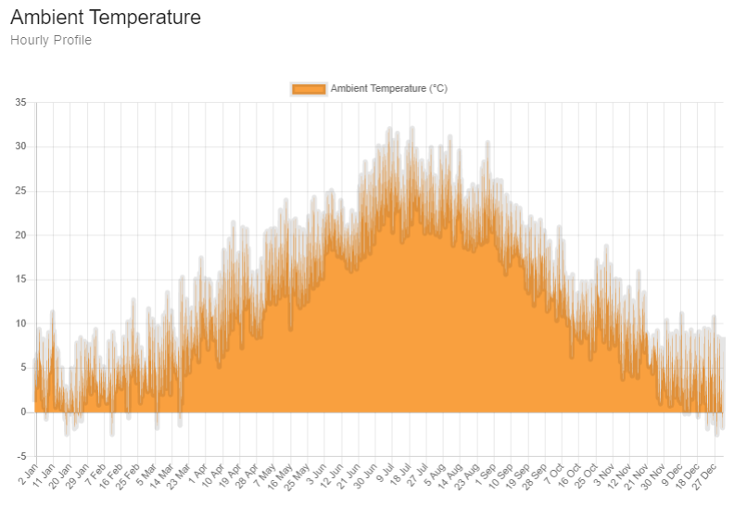
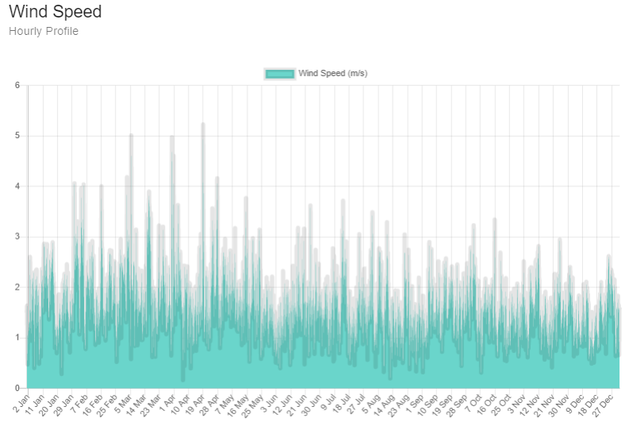
Module 2/5
Outputs:
Solar irradiance (hourly profile)
Optimized angles (slope and azimuth)
Usable area
Total corrective factor
Ambient temperature (hourly profile)
Wind speed (hourly profile)

Slide 6
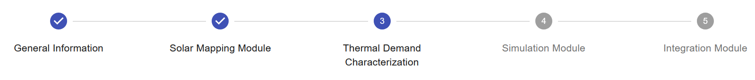
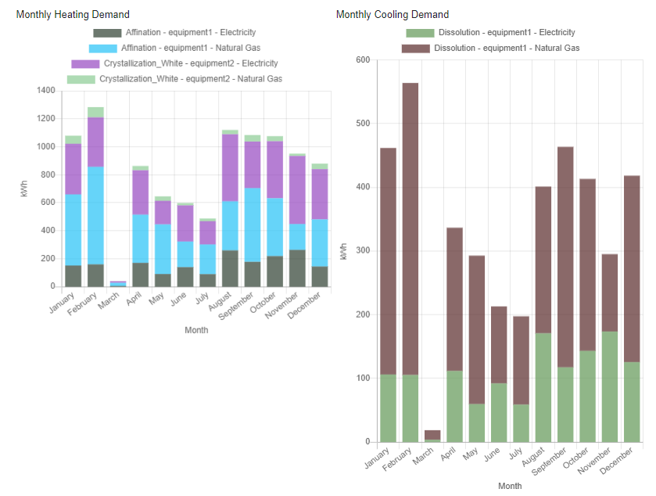
Module 3/5
Outputs:
Total thermal demand
Heating demand & Cooling demand
Monthly demand distribution
Process operating temperature
Details of the thermal demand for each single process
Notes:
The outputs from DCM are provided on an hourly basis thermal demand for a whole year.

Slide 7
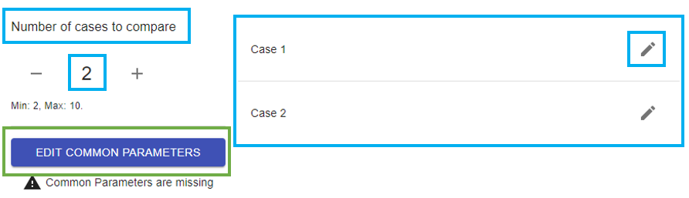
Module 4/5
Simulation Module [CEA]
This module provides the yearly solar heat delivered to the process by the user-defined solar plant (solar field and thermal storage).
Several Key Performance Indicators are calculated to help the user evaluate the benefit of the solar plant from a technical, environmental or economic point of view.

Slide 8
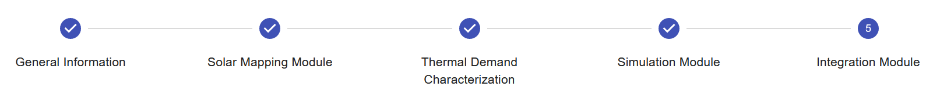
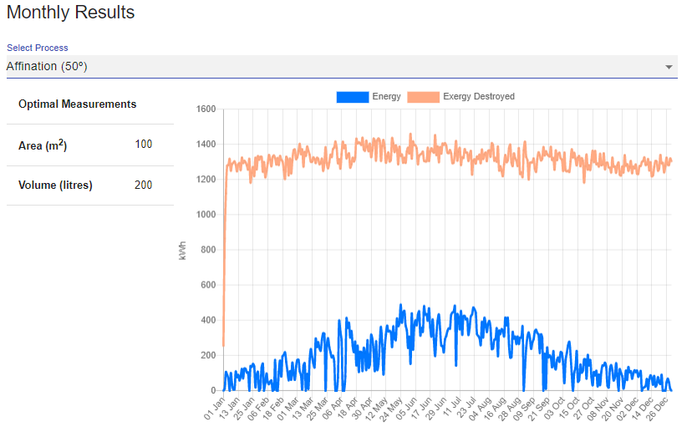
Module 5/5
Outputs:
Yearly results
Optimal area and volume for the solar design
Monthly results
The best combination of processes to be fed by the solar energy (in monthly basis)
Notes:
As a result, in a yearly and monthly basis, the best combination of processes to be fed by the solar energy is presented, with the optimal area and volume for the solar design.

Slide 9
Where do I find the Replication Tool?
Thank you!
https://replicationtool.ship2fair.cloud
(Currently in Beta testing)
Francesco Peccianti - RINA Consulting
francesco.peccianti@rina.org

